Slide 1

PUBLIC PROCUreMENT POLICY
Msmed act,2006

Slide 2

MSMED,2006
The MSMED Act of 2006 primarily aims to achieve the following four objectives:
Promotion of MSMEs: Encourage the development, promotion, and enhancement of micro, small, and medium enterprises (MSMEs) across various sectors of the economy.
Facilitating Growth: Facilitate the growth and competitiveness of MSMEs by providing them with easier access to credit, technology, marketing assistance, and other support services.
Regulatory Framework: Establish a regulatory framework for the classification and categorization of MSMEs based on their investment in plant and machinery or equipment, thereby ensuring targeted support and benefits.
Institutional Support: Create institutional mechanisms and support systems at both the central and state levels to implement and monitor the provisions of the Act effectively, ensuring timely delivery of benefits and services to MSMEs.

Slide 3
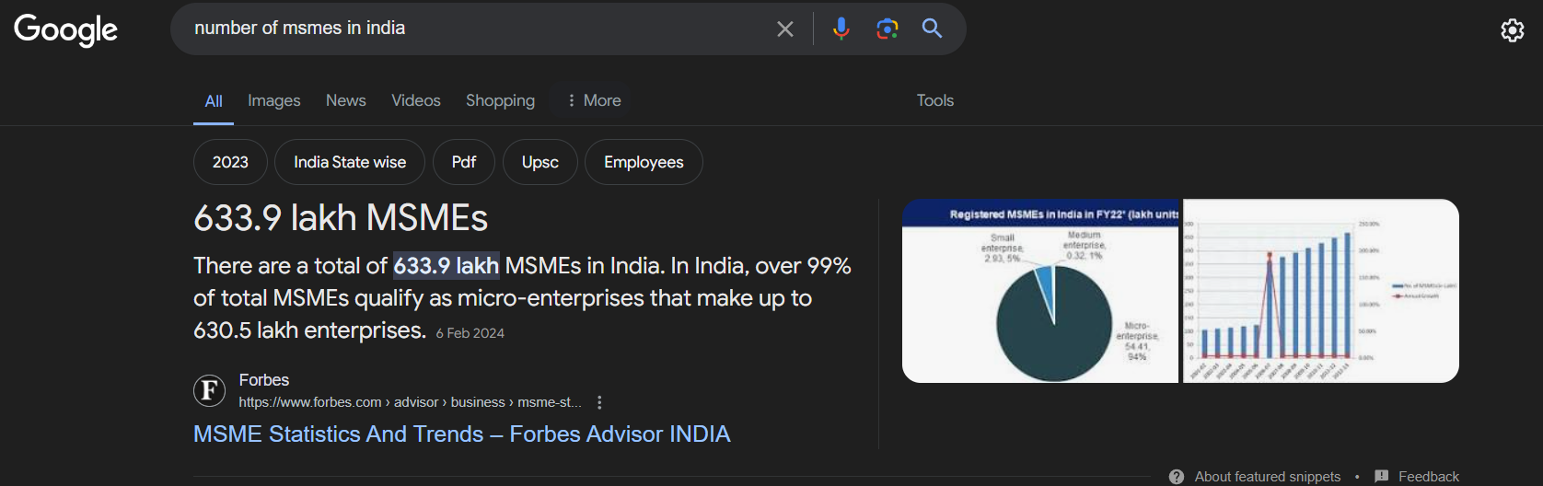
ABOUT MSME:
63 million micro, small, and medium enterprises (MSMEs) according to government statistics
They contribute to around 35% of production
45-48% export
99% of which is micro
Competition
Mortality rate-50%
2012,2006

Slide 4
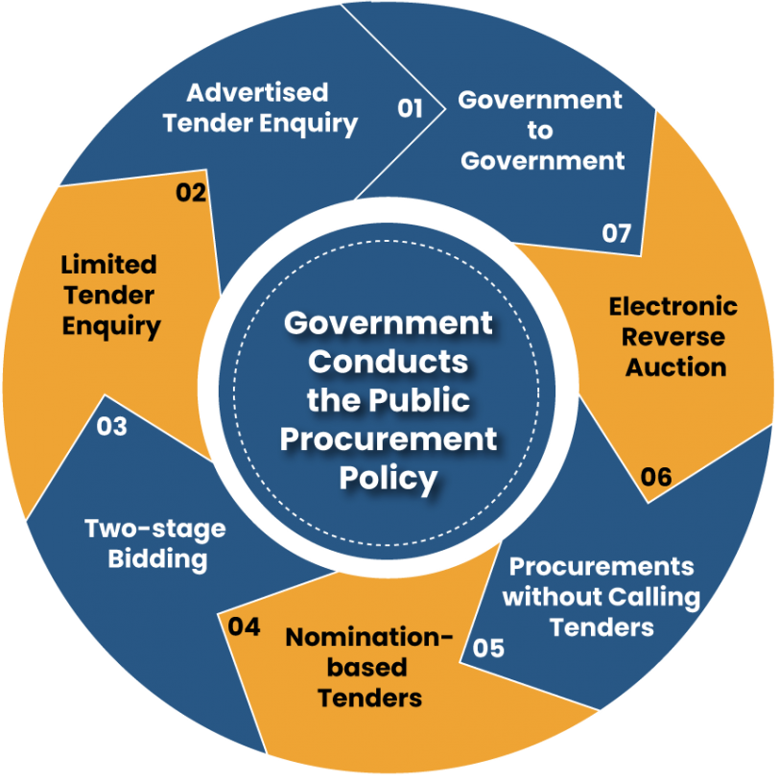
Public Procurement policy
India's MSME sector plays a crucial role in the socio- economic development of the country. It contributes about 8% to country's GDP. It accounts for 45% of the country's manufacturing output and 40% of exports. The sector employs 60 million people in 26 million units producing over 6,000 products.
Procurement is the acquisition of goods or services. It is favorable that the goods/services are appropriate and that they are procured at the best possible cost to meet the needs of the purchaser in terms of quality and quantity, time, and location

Slide 5
Why Public Procurement policy?
Given the present global situation of an impending or even continuing economic slowdown, creating demand within our own vast market for products produced by our own industries, would be a good buffer to ward off the negative impact. With assured public procurement, the MSE sector has only itself as a competitor among its vast variety of products. It will not only encourage better marketing strategies but also an incentive for new designs and technologies so that their produce can compete even in international markets. This will also have a stabilizing effect on market fluctuations of demand and supply and liquidity crisis

Slide 6


RESERVATIONS BENIFITS
20% TO 25% CHANGE
4% SC ST
3% Women
Free Tender Fee
Earnest Money Waiver
Allocating 4% for SC/ST communities ensures inclusive participation and representation in procurement processes.
Reserving 3% for women-owned businesses promotes gender equality and empowers female entrepreneurs in procurement opportunities.
Waiving tender fees facilitates broader access to procurement bids, encouraging more businesses to participate without financial barriers.
The waiver of earnest money encourages wider vendor participation by eliminating financial burdens, particularly for small and medium-sized enterprises.
25% procurement from msmes is reserved.
Earlier this limit was 20%.
Also the actual procurement is always seen to exceed the 25% mark.

Slide 7
Pricing dilemma
Big corporations pricing stratergies
Overcoating of price
Lowest bid- L1
L1+15%
Big corporations often employ sophisticated pricing strategies, such as dynamic pricing and value-based pricing, to maximize profits and market share.
Overcoating of price, a tactic where corporations add a margin to their costs to ensure profitability, is commonly utilized to hedge against uncertainties and risks.
The "Lowest bid-L1" strategy involves selecting the vendor with the lowest bid price, emphasizing cost efficiency in procurement decisions.
L1+15% strategy entails accepting the lowest bid but adding a predetermined percentage (e.g., 15%) to ensure a fair profit margin for the vendor while maintaining competitiveness.

Slide 8

Pricing dilemma
The MICRO & SMALL ENTERPRISES (MSES) participating in a tender quoting price within the band of L1+15% may also be allowed to supply at Ll price where Ll price is from someone other than an MSE Such MSEs may be allowed to supply up to 20% of the total tendered value. In case of more than one such MSEs, the supply will be shared equally

Slide 9
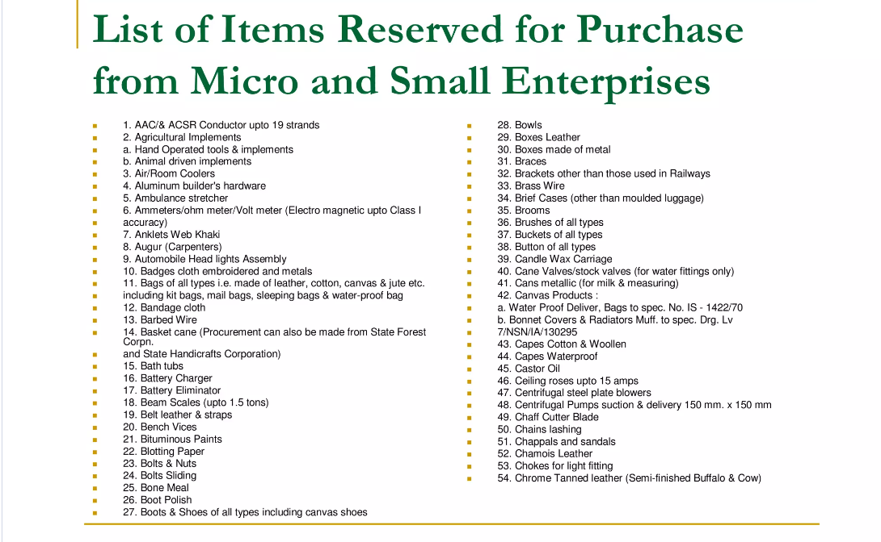
Reserved items
358 reserved items includes:
Link: https://www.dcmsme.gov.in/schemes/listof358itemsreserved.pdf

Slide 10
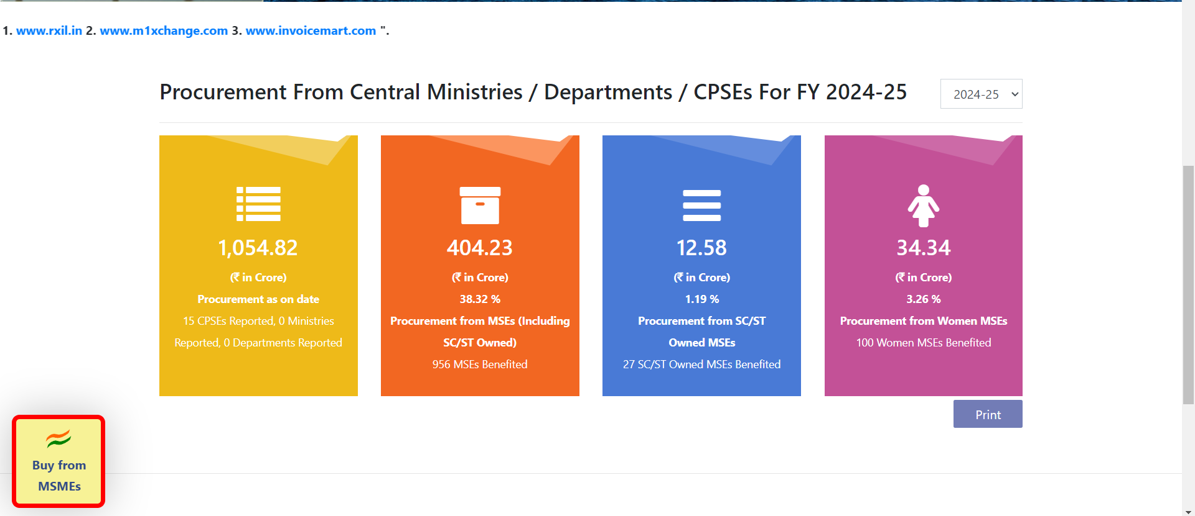
Sambandh portal
Is a portal to connect supplier ,buyers and manufactures.
Champions portal
Sambandh portal facilitates MSMEs to register grievances, seek information, and access various government schemes and initiatives for business growth

Slide 11

Uam(udyog aadhar memorendum)
Steps to apply for Udyog Aadhaar Memorandum:
Visit the official Udyog Aadhaar portal.
Fill in the necessary details such as Aadhaar number, name, social category, business activity, etc.
Verify the details provided through OTP sent to the registered mobile number linked with Aadhaar.
Once verified, submit the application.
Receive the Udyog Aadhaar Memorandum (UAM) certificate instantly, which serves as a unique identification for your MSME.
Use the UAM certificate to avail various benefits and schemes offered by the government for MSMEs.
Udyog Aadhaar Memorandum is a unique identifier for MSMEs, simplifying registration and availing benefits like subsidies, loans, and concessions.
NSIC registration.

Slide 12
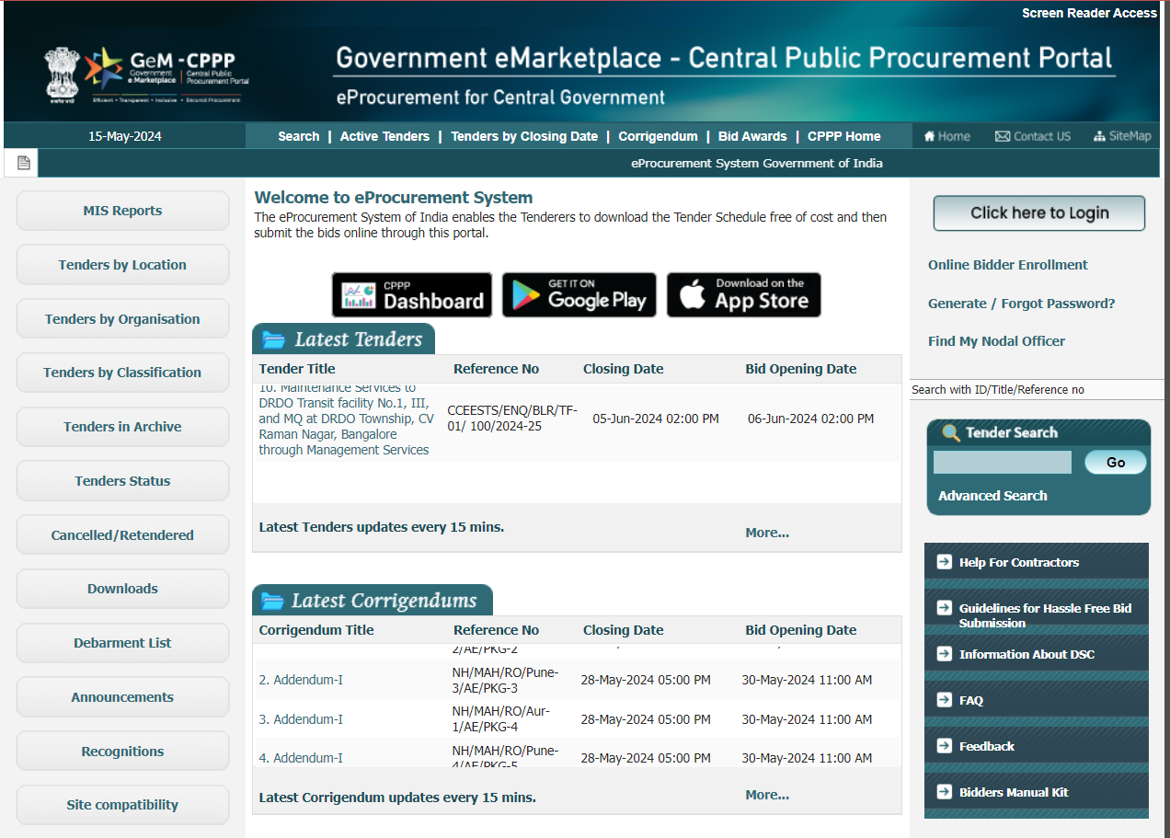
CPPP portal
Is a portal to for all ministry's tender.
Ministry of Finance
The Central Public Procurement Portal of Government of India facilitates all the Central Government Organisations to publish their Tender Enquiries, Corrigenda and Award of Contract details.

Slide 13
Vendor Development Programmes or Buyer Seller Meets
Vendor Development Programs (VDPs) and Buyer Seller Meets (BSMs) are initiatives aimed at fostering relationships between buyers and sellers, particularly within the MSME sector. Here are three points highlighting their significance:
Networking Opportunities: VDPs and BSMs provide platforms for small and medium-sized enterprises (SMEs) to connect with potential buyers or larger organizations. These events facilitate networking among industry players, allowing SMEs to showcase their products or services directly to interested buyers. Such interactions can lead to valuable business partnerships and collaborations.
Market Access and Expansion: For SMEs, accessing markets and expanding their customer base can be challenging. VDPs and BSMs bridge this gap by bringing together buyers and sellers from diverse sectors and geographical regions. SMEs can leverage these platforms to explore new market opportunities, diversify their customer portfolio, and expand their business reach beyond local boundaries.

Slide 14
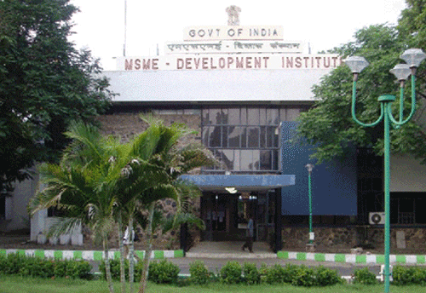

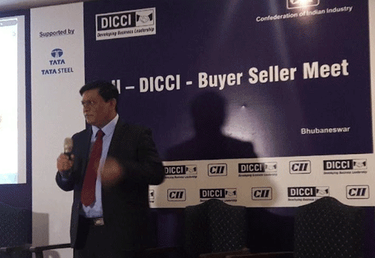
Vendor Development Programmes or Buyer Seller Meets

Slide 15


By:
Om Tiwary
Shadman Hayat Siddique

